Slide 1
Collections Framework
Abhishek S. Rao

Slide 2
Collections Overview
The Collection in Java is a framework that provides an architecture to store and manipulate the group of objects.
Java Collections can achieve all the operations that you perform on a data such as searching, sorting, insertion, manipulation, and deletion.
Java Collection means a single unit of objects. Java Collection framework provides many interfaces (Set, List, Queue, Deque) and classes (ArrayList, Vector, LinkedList, PriorityQueue, HashSet, LinkedHashSet, TreeSet).

Slide 3
The Collections Framework was designed to meet several goals.
First, the framework had to be high-performance. The implementations for the fundamental collections (dynamic arrays, linked lists, trees, and hash tables) are highly efficient.
Second, the framework had to allow different types of collections to work in a similar manner and with a high degree of interoperability.
Third, extending and/or adapting a collection had to be easy.
Algorithms are another important part of the collection mechanism. Algorithms operate on collections and are defined as static methods within the Collections class. Thus, they are available for all collections.

Slide 4
Another item closely associated with the Collections Framework is the Iterator interface.
An iterator offers a general-purpose, standardized way of accessing the elements within a collection, one at a time.
Thus, an iterator provides a means of enumerating the contents of a collection. Because each collection implements Iterator, the elements of any collection class can be accessed through the methods defined by Iterator.
In addition to collections, the framework defines several map interfaces and classes. Maps store key/value pairs.

Slide 5
Recent Changes to Collections
Recently, the Collections Framework underwent a fundamental change that significantly increased its power and streamlined its use. The changes were caused by the addition of generics, autoboxing/unboxing, and the for-each style for loop, by JDK 5.
The addition of generics caused a significant change to the Collections Framework because the entire Collections Framework has been reengineered for it. All collections are now generic, and many of the methods that operate on collections take generic type parameters. Simply put, the addition of generics has affected every part of the Collections Framework.
Generics add the one feature that collections had been missing: type safety. Prior to generics, all collections stored Object references, which meant that any collection could store any type of object. Thus, it was possible to accidentally store incompatible types in a collection. Doing so could result in run-time type mismatch errors.
With generics, it is possible to explicitly state the type of data being stored, and run-time type mismatch errors can be avoided.

Slide 6
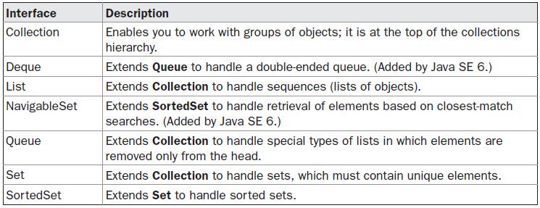
The Collection Interfaces
The Collections Framework defines several interfaces. This section provides an overview of each interface. Beginning with the collection interfaces is necessary because they determine the fundamental nature of the collection classes. Interfaces that underpin collections are summarized in the following table:

Slide 7
The Collection interface is the foundation upon which the Collections Framework is built because it must be implemented by any class that defines a collection. Collection is a generic interface that has this declaration:
interface Collection<E>
Here, E specifies the type of objects that the collection will hold. Collection extends the Iterable interface. This means that all collections can be cycled through by use of the for-each style for loop.
Collection declares the core methods that all collections will have. Because all collections implement Collection, familiarity with its methods is necessary for a clear understanding of the framework. Several of these methods can throw an UnsupportedOperationException.
As explained, this occurs if a collection cannot be modified. AClassCastException is generated when one object is incompatible with another, such as when an attempt is made to add an incompatible object to a collection. A NullPointerException is thrown if an attempt is made to store a null object and null elements are not allowed in the collection. An IllegalArgumentException is thrown if an invalid argument is used. An IllegalStateException is thrown if an attempt is made to add an element to a fixed-length collection that is full.

Slide 8
Objects are added to a collection by calling add( ). Notice that add( ) takes an argument of type E, which means that objects added to a collection must be compatible with the type of data expected by the collection.
You can add the entire contents of one collection to another by calling addAll( ).
You can remove an object by using remove( ).
To remove a group of objects, call removeAll( ).
You can remove all elements except those of a specified group by calling retainAll( ).
To empty a collection, call clear( ).
You can determine whether a collection contains a specific object by calling contains( ).
To determine whether one collection contains all the members of another, call containsAll( ).
You can determine when a collection is empty by calling isEmpty( ).
The number of elements currently held in a collection can be determined by calling size( ).

Slide 9
The toArray( ) methods return an array that contains the elements stored in the invoking collection. The first returns an array of Object. The second returns an array of elements that have the same type as the array specified as a parameter.
Two collections can be compared for equality by calling equals( ). The precise meaning of equality” may differ from collection to collection.
For example, you can implement equals( ) so that it compares the values of elements stored in the collection. Alternatively, equals( ) can compare references to those elements.
One more very important method is iterator( ), which returns an iterator to a collection. Iterators are frequently used when working with collections.

Slide 10
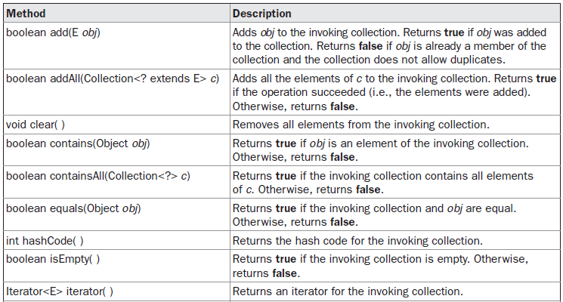
The Methods Defined by Collection

Slide 11
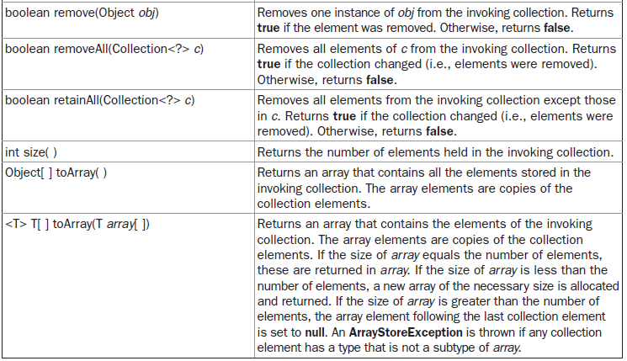

Slide 12
List Interface
The List interface extends Collection and declares the behavior of a collection that stores a sequence of elements.
Elements can be inserted or accessed by their position in the list, using a zero-based index.
A list may contain duplicate elements.
In addition to the methods defined by Collection, List defines some of its own, which are summarized in the following table.
Several of the list methods will throw an UnsupportedOperationException if the collection cannot be modified, and a ClassCastException is generated when one object is incompatible with another.

Slide 13
1 | void add(int index, Object obj) Inserts obj into the invoking list at the index passed in the index. Any pre-existing elements at or beyond the point of insertion are shifted up. Thus, no elements are overwritten.
2 | boolean addAll(int index, Collection c) Inserts all elements of c into the invoking list at the index passed in the index. Any pre-existing elements at or beyond the point of insertion are shifted up. Thus, no elements are overwritten. Returns true if the invoking list changes and returns false otherwise.
3 | Object get(int index) Returns the object stored at the specified index within the invoking collection.
4 | int indexOf(Object obj) Returns the index of the first instance of obj in the invoking list. If obj is not an element of the list, .1 is returned.

Slide 14
5 | int lastIndexOf(Object obj) Returns the index of the last instance of obj in the invoking list. If obj is not an element of the list, .1 is returned.
6 | ListIterator listIterator( ) Returns an iterator to the start of the invoking list.
7 | ListIterator listIterator(int index) Returns an iterator to the invoking list that begins at the specified index.
8 | Object remove(int index) Removes the element at position index from the invoking list and returns the deleted element. The resulting list is compacted. That is, the indexes of subsequent elements are decremented by one.
9 | Object set(int index, Object obj) Assigns obj to the location specified by index within the invoking list.
10 | List subList(int start, int end) Returns a list that includes elements from start to end.1 in the invoking list. Elements in the returned list are also referenced by the invoking object.

Slide 15
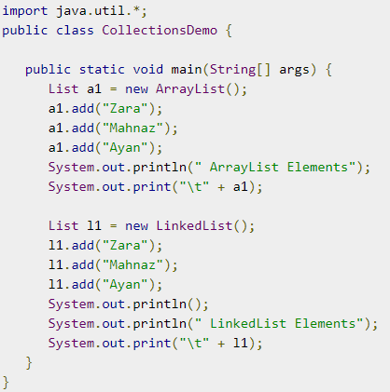

Slide 16
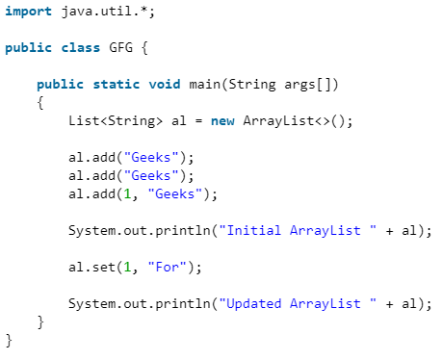

Slide 17
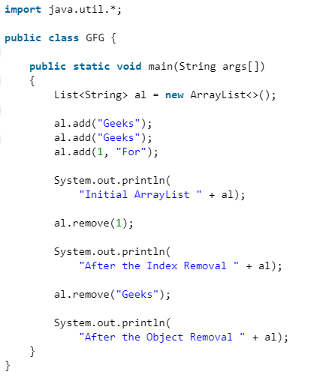

Slide 18
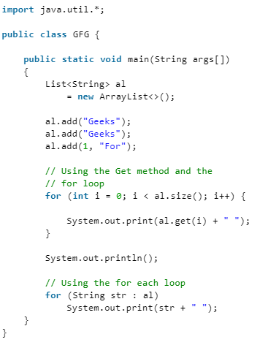

Slide 19
The Set Interface
The Set interface defines a set. It extends Collection and declares the behavior of a collection that does not allow duplicate elements.
Therefore, the add( ) method returns false if an attempt is made to add duplicate elements to a set. It does not define any additional methods of its own.
Set is a generic interface that has this declaration:
interface Set<E>
Here, E specifies the type of objects that the set will hold.

Slide 20
import java.util.*;
public class SetExample {
public static void main(String[] args)
{
// Set demonstration using HashSet
Set<String> hash_Set = new HashSet<String>();
hash_Set.add("Geeks");
hash_Set.add("For");
hash_Set.add("Geeks");
hash_Set.add("Example");
hash_Set.add("Set");
System.out.println(hash_Set);
}
}

Slide 21
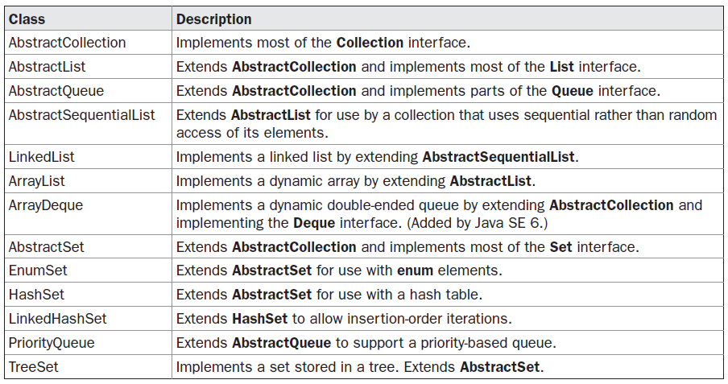
The standard collection classes are summarized in the following table:

Slide 22
The ArrayList Class
The ArrayList class extends AbstractList and implements the List interface. ArrayList is a generic class that has this declaration:
class ArrayList<E>
Here, E specifies the type of objects that the list will hold.
ArrayList supports dynamic arrays that can grow as needed. In Java, standard arrays are of a fixed length. After arrays are created, they cannot grow or shrink, which means that you must know in advance how many elements an array will hold. But, sometimes, you may not know until run time precisely how large an array you need.
To handle this situation, the Collections Framework defines ArrayList. In essence, an ArrayList is a variable-length array of object references. That is, an ArrayList can dynamically increase or decrease in size.

Slide 23
Array lists are created with an initial size. When this size is exceeded, the collection is automatically enlarged. When objects are removed, the array can be shrunk.
ArrayList has the constructors shown here:
ArrayList( )
ArrayList(Collection<? extends E> c)
ArrayList(int capacity)
The first constructor builds an empty array list.
The second constructor builds an array list that is initialized with the elements of the collection c.
The third constructor builds an array list that has the specified initial capacity. The capacity is the size of the underlying array that is used to store the elements. The capacity grows automatically as elements are added to an array list.

Slide 24
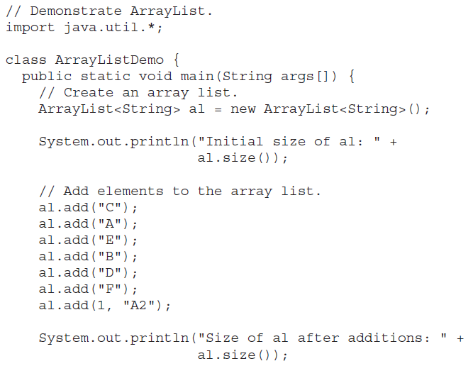

Slide 25
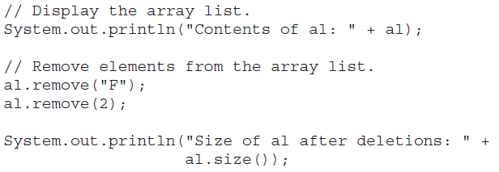
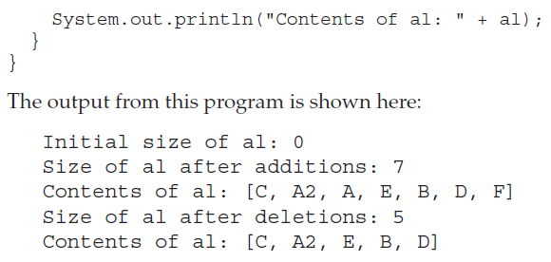

Slide 26
Obtaining an Array from an ArrayList
When working with ArrayList, you will sometimes want to obtain an actual array that contains the contents of the list. You can do this by calling toArray( ), which is defined by Collection.
Several reasons exist why you might want to convert a collection into an array, such as:
To obtain faster processing times for certain operations
To pass an array to a method that is not overloaded to accept a collection
To integrate collection-based code with legacy code that does not understand collections
There are two versions of toArray( ), which are shown again here for your convenience:
Object[ ] toArray( )
<T> T[ ] toArray(T array[ ])

Slide 27
The first returns an array of Object. The second returns an array of elements that have the same type as T. Normally, the second form is more convenient because it returns the proper type of array. The following program demonstrates its use:

Slide 28
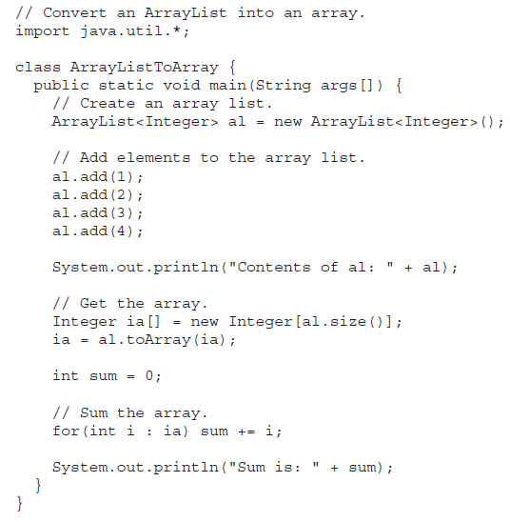
The output from the program is shown here:
Contents of al: [1, 2, 3, 4]
Sum is: 10

Slide 29
The LinkedList Class
The LinkedList class extends AbstractSequentialList and implements the List, Deque, and Queue interfaces. It provides a linked-list data structure. LinkedList is a generic class that has this declaration:
class LinkedList<E>
Here, E specifies the type of objects that the list will hold. LinkedList has the two constructors shown here:
LinkedList( )
LinkedList(Collection<? extends E> c)
The first constructor builds an empty linked list. The second constructor builds a linked list that is initialized with the elements of the collection c.

Slide 30
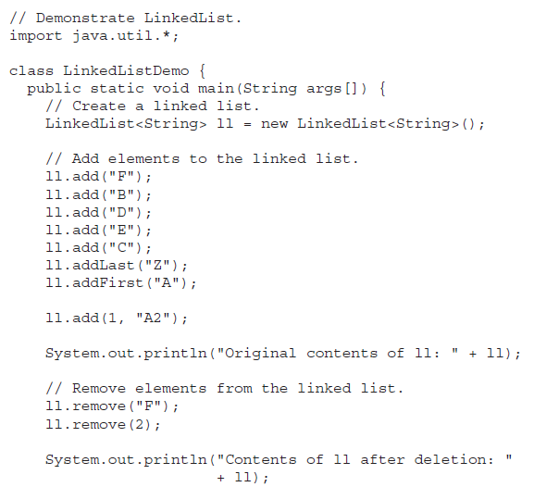

Slide 31
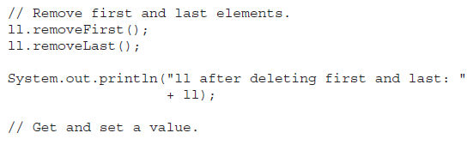
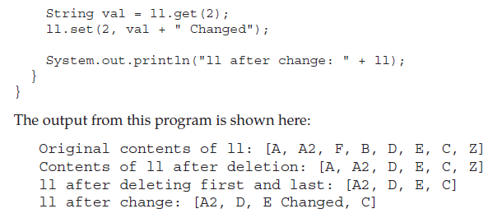

Slide 32
The HashSet Class
HashSet extends AbstractSet and implements the Set interface. It creates a collection that uses a hash table for storage. HashSet is a generic class that has this declaration:
class HashSet<E>
Here, E specifies the type of objects that the set will hold.
In hashing, the informational content of a key is used to determine a unique value, called its hash code. The hash code is then used as the index at which the data associated with the key is stored. The transformation of the key into its hash code is performed automatically. Also, your code can’t directly index the hash table. The advantage of hashing is that it allows the execution time of add( ), contains( ), remove( ), and size( ) to remain constant even for large sets.

Slide 33
The following constructors are defined:
HashSet( )
HashSet(Collection<? extends E> c)
HashSet(int capacity)
HashSet(int capacity, float fillRatio)
The first form constructs a default hash set. The second form initializes the hash set by using the elements of c. The third form initializes the capacity of the hash set to capacity. (The default capacity is 16.) The fourth form initializes both the capacity and the fill ratio (also called load capacity) of the hash set from its arguments. The fill ratio must be between 0.0 and 1.0, and it determines how full the hash set can be before it is resized upward. Specifically, when the number of elements is greater than the capacity of the hash set multiplied by its fill ratio, the hash set is expanded. For constructors that do not take a fill ratio, 0.75 is used.
It is important to note that HashSet does not guarantee the order of its elements, because the process of hashing doesn’t usually lend itself to the creation of sorted sets. If you need sorted storage, then another collection, such as TreeSet, is a better choice.

Slide 34
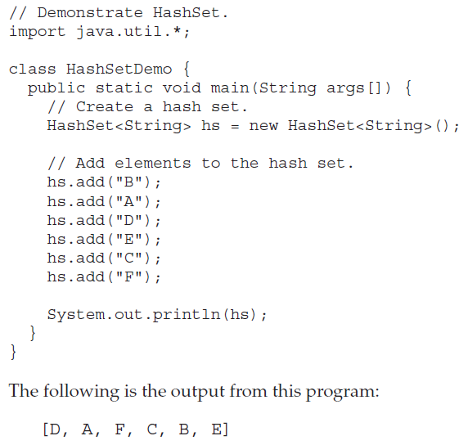

Slide 35
The LinkedHashSet Class
The LinkedHashSet class extends HashSet and adds no members of its own. It is a generic class that has this declaration:
class LinkedHashSet<E>
Here, E specifies the type of objects that the set will hold. Its constructors parallel those in HashSet.
LinkedHashSet maintains a linked list of the entries in the set, in the order in which they were inserted. This allows insertion-order iteration over the set.
That is, when cycling through a LinkedHashSet using an iterator, the elements will be returned in the order in which they were inserted.
This is also the order in which they are contained in the string returned by toString( ) when called on a LinkedHashSet object. To see the effect of LinkedHashSet, try substituting LinkedHashSet for HashSet in the preceding program.
The output will be
[B, A, D, E, C, F]
which is the order in which the elements were inserted.

Slide 36
The TreeSet Class
TreeSet extends AbstractSet and implements the NavigableSet interface. It creates a collection that uses a tree for storage. Objects are stored in sorted, ascending order. Access and retrieval times are quite fast, which makes TreeSet an excellent choice when storing large amounts of sorted information that must be found quickly.
TreeSet is a generic class that has this declaration:
class TreeSet<E>
Here, E specifies the type of objects that the set will hold.
TreeSet has the following constructors:
TreeSet( )
TreeSet(Collection<? extends E> c)
TreeSet(Comparator<? super E> comp)
TreeSet(SortedSet<E> ss)

Slide 37
The first form constructs an empty tree set that will be sorted in ascending order according to the natural order of its elements. The second form builds a tree set that contains the elements of c. The third form constructs an empty tree set that will be sorted according to the comparator specified by comp. The fourth form builds a tree set that contains the elements of ss.

Slide 38
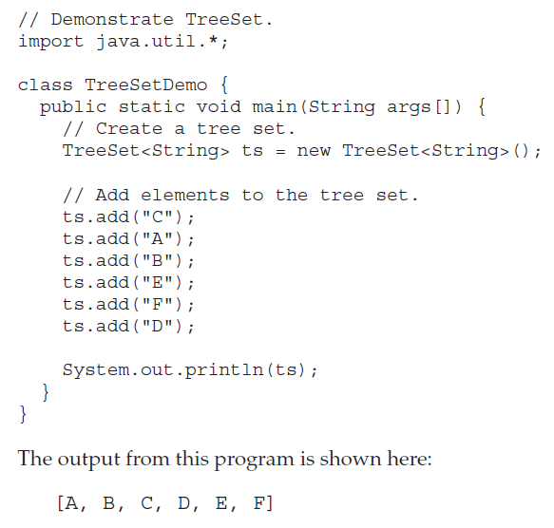

Slide 39
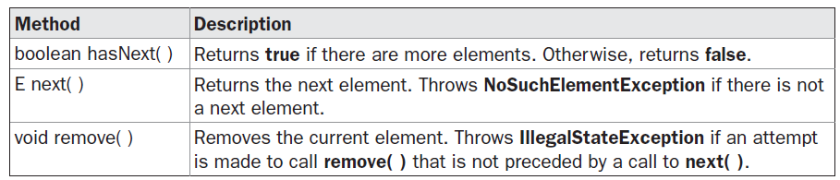
Accessing a Collection via an Iterator
Often, you will want to cycle through the elements in a collection. For example, you might want to display each element. One way to do this is to employ an iterator, which is an object that implements either the Iterator or the ListIterator interface. Iterator enables you to cycle through a collection, obtaining or removing elements.

Slide 40
Iterator and ListIterator
are generic interfaces which are declared as shown here:
interface Iterator<E>
interface ListIterator<E>
Here, E specifies the type of objects being iterated. The Iterator interface declares the methods shown in Table.
Using an Iterator
Before you can access a collection through an iterator, you must obtain one. Each of the collection classes provides an iterator( ) method that returns an iterator to the start of the collection. By using this iterator object, you can access each element in the collection, one element at a time.

Slide 41
In general, to use an iterator to cycle through the contents of a collection, follow these steps:
1. Obtain an iterator to the start of the collection by calling the collection’s iterator( ) method.
2. Set up a loop that makes a call to hasNext( ). Have the loop iterate as long as hasNext( ) returns true.
3. Within the loop, obtain each element by calling next( ).
For collections that implement List, you can also obtain an iterator by calling listIterator( ). As explained, a list iterator gives you the ability to access the collection in either the forward or backward direction and lets you modify an element. Otherwise, ListIterator is used just like Iterator.

Slide 42
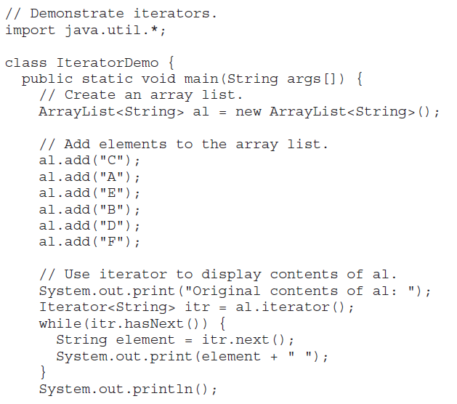

Slide 43
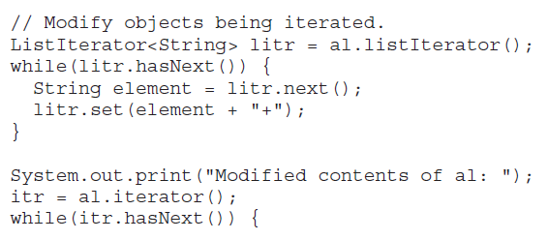
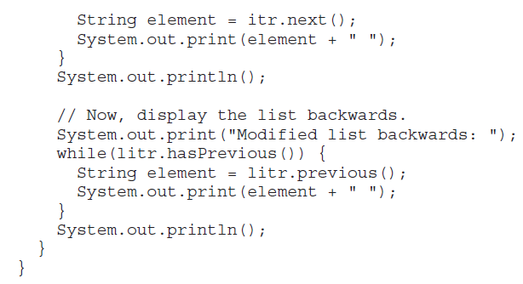

Slide 44
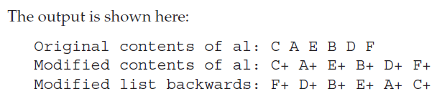

Slide 45
The For-Each Alternative to Iterators
If you won’t be modifying the contents of a collection or obtaining elements in reverse order, then the for-each version of the for loop is often a more convenient alternative to cycling through a collection than is using an iterator. Recall that the for can cycle through any collection of objects that implement the Iterable interface. Because all of the collection classes implement this interface, they can all be operated upon by the for.
The following example uses a for loop to sum the contents of a collection:

Slide 46
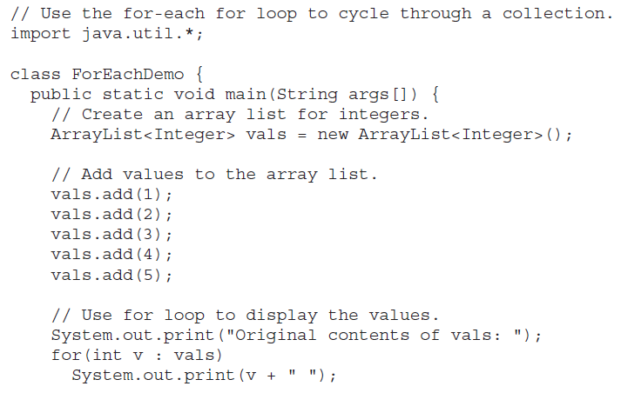

Slide 47
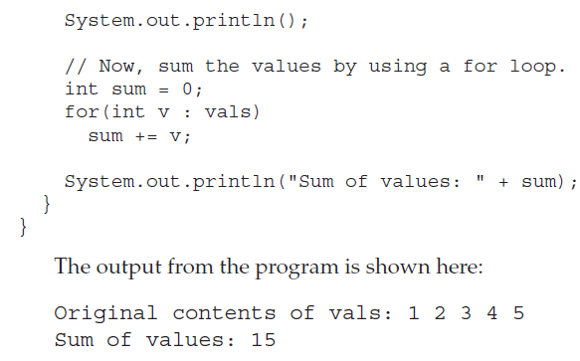

Slide 48
For the sake of simplicity, the foregoing examples have stored built-in objects, such as String or Integer, in a collection. Of course, collections are not limited to the storage of built-in objects.
Quite the contrary. The power of collections is that they can store any type of object, including objects of classes that you create. For example, consider the following example that uses a LinkedList to store mailing addresses:

Slide 49
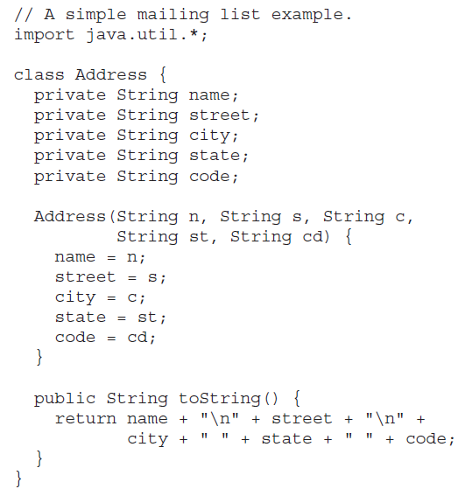

Slide 50
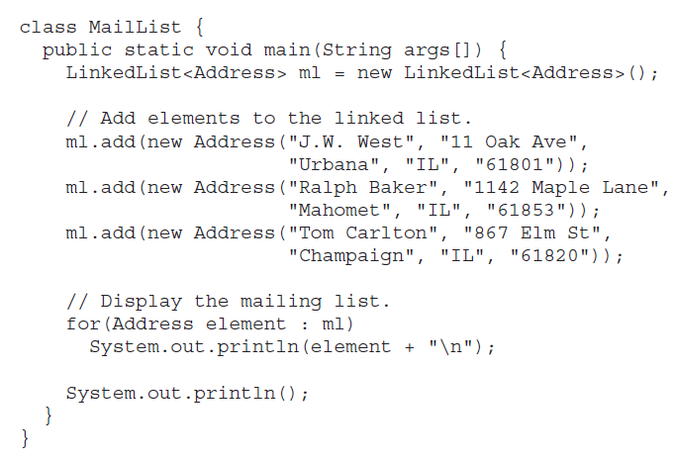

Slide 51
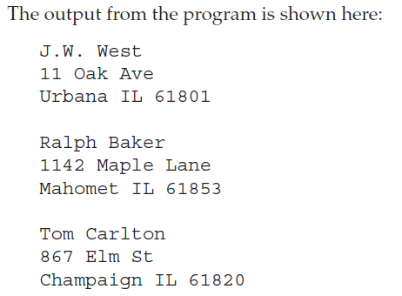

Slide 52
Working with Maps
A map is an object that stores associations between keys and values, or key/value pairs. Given a key, you can find its value. Both keys and values are objects. The keys must be unique, but the values may be duplicated. Some maps can accept a null key and null values, others cannot.
The Map Interface
The Map interface maps unique keys to values. A key is an object that you use to retrieve a value. Given a key and a value, you can store the value in a Map object. After the value is stored, you can retrieve it by using its key. Map is generic and is declared as shown here:
interface Map<K, V>
Here, K specifies the type of keys, and V specifies the type of values.

Slide 53
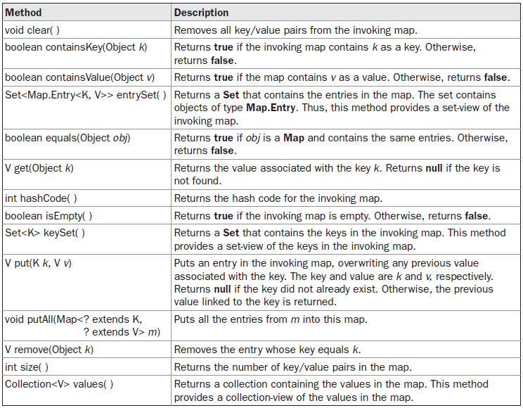
The methods declared by Map are summarized in Table

Slide 54
Several methods throw a ClassCastException when an object is incompatible with the elements in a map.
A NullPointerException is thrown if an attempt is made to use a null object and null is not allowed in the map. An UnsupportedOperationException is thrown when an attempt is made to change an unmodifiable map. An IllegalArgumentException is thrown if an invalid argument is used.
Maps revolve around two basic operations: get( ) and put( ). To put a value into a map, use put( ), specifying the key and the value. To obtain a value, call get( ), passing the key as an argument. The value is returned.

Slide 55
import java.util.*;
class MapDemo {
public static void main(String args[])
{
Map<Integer, String> hm1 = new HashMap<Integer, String>();
// Inserting the Elements
hm1.put(new Integer(1), “Hello");
hm1.put(new Integer(2), “Welcome");
hm1.put(new Integer(3), “To");
hm1.put(new Integer(4), “Java");
// Initial Map
System.out.println(hm1);
hm1.remove(new Integer(4));
// Final Map
System.out.println(hm1);
}
}

Slide 56
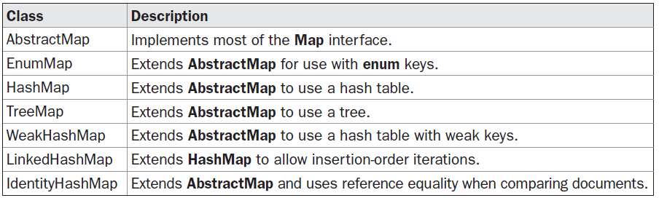
The Map Classes
Several classes provide implementations of the map interfaces. The classes that can be used for maps are summarized here:

Slide 57
The HashMap Class
The HashMap class extends AbstractMap and implements the Map interface. It uses a hash table to store the map. This allows the execution time of get( ) and put( ) to remain constant even for large sets.
HashMap is a generic class that has this declaration:
class HashMap<K, V>
Here, K specifies the type of keys, and V specifies the type of values.
The following constructors are defined:
HashMap( )
HashMap(Map<? extends K, ? extends V> m)
HashMap(int capacity)
HashMap(int capacity, float fillRatio)

Slide 58
The first form constructs a default hash map. The second form initializes the hash map by using the elements of m. The third form initializes the capacity of the hash map to capacity. The fourth form initializes both the capacity and fill ratio of the hash map by using its arguments.
The meaning of capacity and fill ratio is the same as for HashSet, described earlier. The
default capacity is 16. The default fill ratio is 0.75.
HashMap implements Map and extends AbstractMap. It does not add any methods of its own. You should note that a hash map does not guarantee the order of its elements. Therefore, the order in which elements are added to a hash map is not necessarily the order in which they are read by an iterator.

Slide 59
import java.util.HashMap;
public class GFG {
public static void main(String[] args)
{
// Create an empty hash map
HashMap<String, Integer> map = new HashMap<>();
// Add elements to the map
map.put("vishal", 10);
map.put("sachin", 30);
map.put("vaibhav", 20);
// Print size and content
System.out.println("Size of map is:- " + map.size());
System.out.println(map);
// Check if a key is present and if
// present, print value
if (map.containsKey("vishal")) {
Integer a = map.get("vishal");
System.out.println("value for key"
+ " \"vishal\" is:- " + a);
}
}
}

Slide 60
The TreeMap Class
The TreeMap class extends AbstractMap and implements the NavigableMap interface.
It creates maps stored in a tree structure. A TreeMap provides an efficient means of storing key/value pairs in sorted order and allows rapid retrieval. You should note that, unlike a hash map, a tree map guarantees that its elements will be sorted in ascending key order.
TreeMap is a generic class that has this declaration:
class TreeMap<K, V>
Here, K specifies the type of keys, and V specifies the type of values.
The following TreeMap constructors are defined:
TreeMap( )
TreeMap(Comparator<? super K> comp)
TreeMap(Map<? extends K, ? extends V> m)
TreeMap(SortedMap<K, ? extends V> sm)

Slide 61
The first form constructs an empty tree map that will be sorted by using the natural order of its keys.
The second form constructs an empty tree-based map that will be sorted by using the Comparator comp.
The third form initializes a tree map with the entries from m, which will be sorted by using the natural order of the keys. The fourth form initializes a tree map with the entries from sm, which will be sorted in the same order as sm.

Slide 62
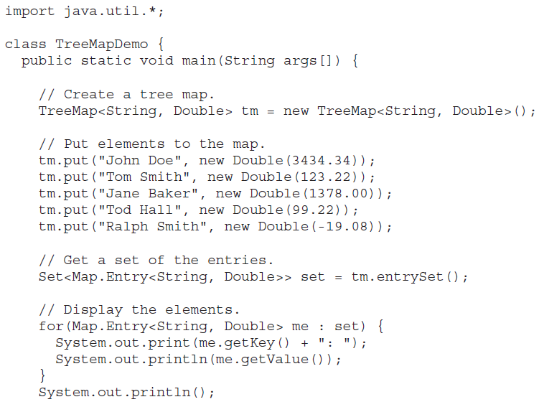

Slide 63
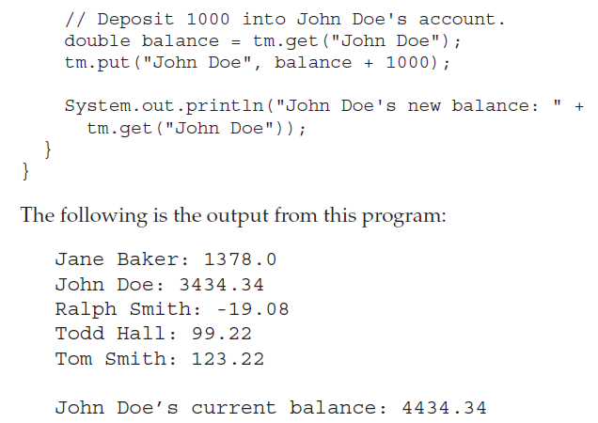

Slide 64
The LinkedHashMap Class
LinkedHashMap extends HashMap. It maintains a linked list of the entries in the map, in the order in which they were inserted. This allows insertion-order iteration over the map. That is, when iterating through a collection-view of a LinkedHashMap, the elements will be returned in the order in which they were inserted.
You can also create a LinkedHashMap that returns its elements in the order in which they were last accessed. LinkedHashMap is a generic class that has this declaration:
class LinkedHashMap<K, V>
Here, K specifies the type of keys, and V specifies the type of values.
LinkedHashMap defines the following constructors:
LinkedHashMap( )
LinkedHashMap(Map<? extends K, ? extends V> m)
LinkedHashMap(int capacity)
LinkedHashMap(int capacity, float fillRatio)
LinkedHashMap(int capacity, float fillRatio, boolean Order)

Slide 65
The first form constructs a default LinkedHashMap.
The second form initializes the LinkedHashMap with the elements from m.
The third form initializes the capacity.
The fourth form initializes both capacity and fill ratio. The meaning of capacity and fill ratio are the same as for HashMap. The default capactiy is 16. The default ratio is 0.75.
The last form allows you to specify whether the elements will be stored in the linked list by insertion order, or by order of last access. If Order is true, then access order is used. If Order is false, then insertion order is used.

Slide 66
package javapack;
import java.util.*;
public class BasicLinkedHashMap
{
public static void main(String a[])
{
HashMap<String, String> lhm = new LinkedHashMap<String, String>();
lhm.put("one", "ONE");
lhm.put("two", "TWO");
lhm.put("three", "THREE");
System.out.println(lhm);
System.out.println("Getting value for key 'one': " + lhm.get("one"));
System.out.println("Size of the map: " + lhm.size());
System.out.println("Is map empty? " + lhm.isEmpty());
System.out.println("Contains key 'two'? "+ lhm.containsKey("two"));
System.out.println("Contains value 'ONE'? " + lhm.containsValue("ONE"));
System.out.println("delete element 'one': " + lhm.remove("one"));
System.out.println(lhm);
}
}

Slide 67
Using a Comparator
The following is an example that demonstrates the power of a custom comparator. It implements the compare( ) method for strings that operates in reverse of normal. Thus, it causes a tree set to be stored in reverse order.

Slide 68
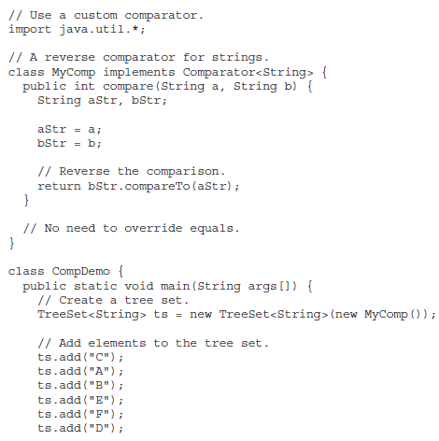

Slide 69
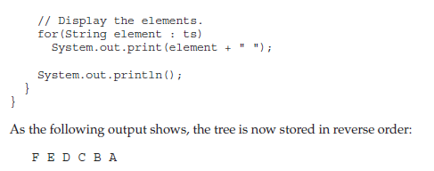

Slide 70
What Are Generics?
At its core, the term generics means parameterized types. Parameterized types are important because they enable you to create classes, interfaces, and methods in which the type of data upon which they operate is specified as a parameter.
Using generics, it is possible to create a single class, for example, that automatically works with different types of data. A class, interface, or method that operates on a parameterized type is called generic, as in generic class or generic method.
It is important to understand that Java has always given you the ability to create generalized classes, interfaces, and methods by operating through references of type Object. Because Object is the superclass of all other classes, an Object reference can refer to any type object.
Thus, in pre-generics code, generalized classes, interfaces, and methods used Object references to operate on various types of objects. The problem was that they could not do so with type safety.
Generics add the type safety that was lacking. They also streamline the process, because it is no longer necessary to explicitly employ casts to translate between Object and the type of data that is being operated upon.
With generics, all casts are automatic and implicit. Thus, generics expand your ability to reuse code and let you do so safely and easily.

Slide 71
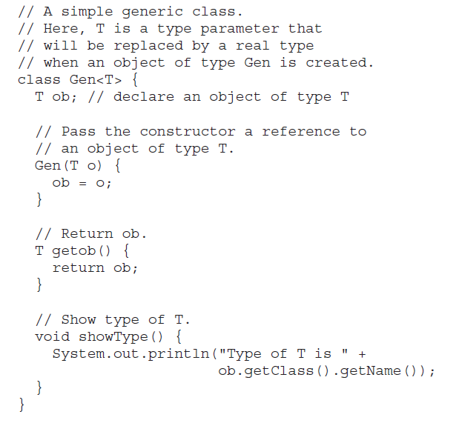

Slide 72
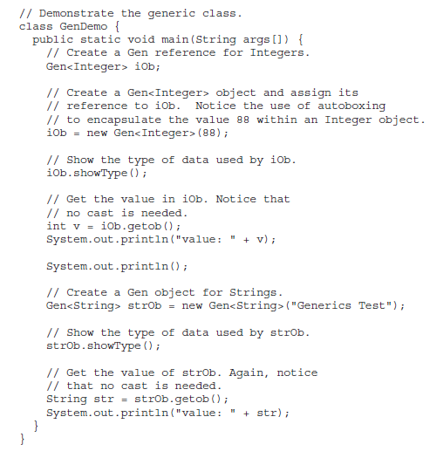

Slide 73
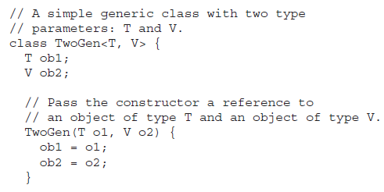
A Generic Class with Two Type Parameters
You can declare more than one type parameter in a generic type. To specify two or more type parameters, simply use a comma-separated list. For example, the following TwoGen class is a variation of the Gen class that has two type parameters:

Slide 74
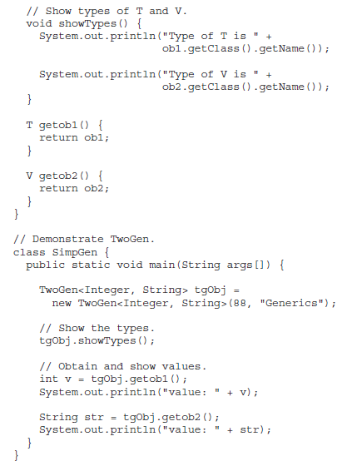
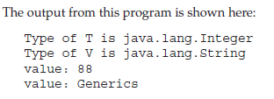

Slide 75
Bounded Types
In the preceding examples, the type parameters could be replaced by any class type. This is fine for many purposes, but sometimes it is useful to limit the types that can be passed to a type parameter.
For example, assume that you want to create a generic class that contains a method that returns the average of an array of numbers. Furthermore, you want to use the class to obtain the average of an array of any type of number, including integers, floats, and doubles.

Slide 76
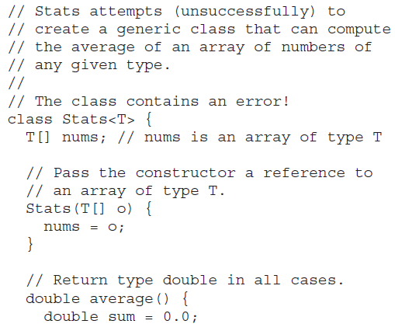

Slide 77
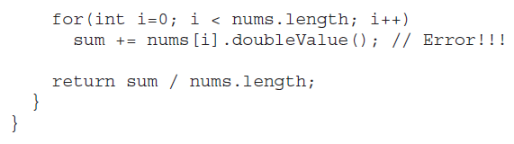

Slide 78
In Stats, the average( ) method attempts to obtain the double version of each number in the nums array by calling doubleValue( ). Because all numeric classes, such as Integer and Double, are subclasses of Number, and Number defines the doubleValue( ) method, this method is available to all numeric wrapper classes.
The trouble is that the compiler has no way to know that you are intending to create Stats objects using only numeric types. Thus, when you try to compile Stats, an error is reported that indicates that the doubleValue( )method is unknown.
To solve this problem, you need some way to tell the compiler that you intend to pass only numeric types to T. Furthermore, you need some way to ensure that only numeric types are actually passed.
To handle such situations, Java provides bounded types. When specifying a type parameter, you can create an upper bound that declares the superclass from which all type arguments must be derived. This is accomplished through the use of an extends clause when specifying the type parameter, as shown here:

Slide 79
<T extends superclass>
This specifies that T can only be replaced by superclass, or subclasses of superclass. Thus, superclass defines an inclusive, upper limit.
You can use an upper bound to fix the Stats class shown earlier by specifying Number as an upper bound, as shown here:

Slide 80
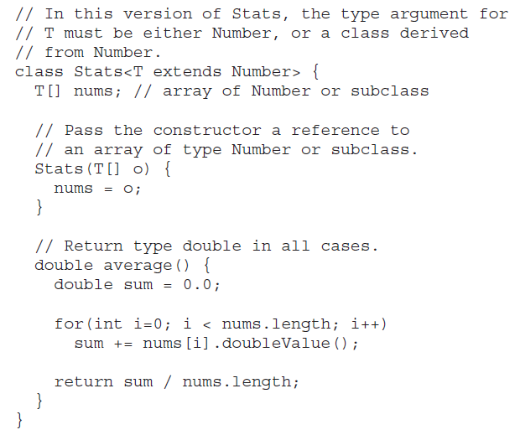

Slide 81
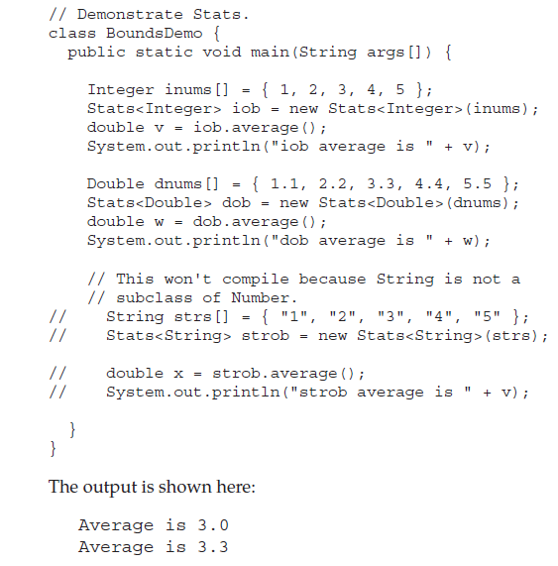

Slide 82
Notice how Stats is now declared by this line:
class Stats<T extends Number> {
Because the type T is now bounded by Number, the Java compiler knows that all objects of type T can call doubleValue( ) because it is a method declared by Number. This is, by itself, a major advantage. However, as an added bonus, the bounding of T also prevents nonnumeric Stats objects from being created. For example, if you try removing the comments from the lines at the end of the program, and then try recompiling, you will receive compile-time errors because String is not a subclass of Number.

Slide 83
Wildcards in Java
The question mark (?) is known as the wildcard in generic programming . It represents an unknown type. The wildcard can be used in a variety of situations such as the type of a parameter, field, or local variable; sometimes as a return type. Unlike arrays, different instantiations of a generic type are not compatible with each other, not even explicitly. This incompatibility may be softened by the wildcard if ? is used as an actual type parameter.
Bounded and unbounded wildcards in Generics are two types of wildcard available on Java. Any Type can be bounded either upper or lower of the class hierarchy in Generics by using bounded wildcards. In short <? extends T> and <? super T> represent bounded wildcards while <?> represent an unbounded wildcard in generics.
Bounded and unbounded wildcards in generics are used to bound any Type. Type can be upper bounded by using <? extends T> where all Types must be sub-class of T or lower bounded using <? super T> where all Types required to be the super class of T, here T represent the lower bound. Single <?> is called an unbounded wildcard in generic and it can represent any type, similar to Object in Java. For example List<?> can represent any List e.g. List<String> or List<Integer> its provides highest level of flexibility on passing method argument.

Slide 84
Types of wildcards in Java:
Upper Bounded Wildcards: These wildcards can be used when you want to relax the restrictions on a variable. For example, say you want to write a method that works on List < integer >, List < double >, and List < number > , you can do this using an upper bounded wildcard.
To declare an upper-bounded wildcard, use the wildcard character (‘?’), followed by the extends keyword, followed by its upper bound.
public static void add(List<? extends Number> list)

Slide 85
//Java program to demonstrate Upper Bounded Wildcards
import java.util.Arrays;
import java.util.List;
class WildcardDemo
{
public static void main(String[] args)
{
//Upper Bounded Integer List
List<Integer> list1= Arrays.asList(4,5,6,7);
//printing the sum of elements in list
System.out.println("Total sum is:"+sum(list1));
//Double list
List<Double> list2=Arrays.asList(4.1,5.1,6.1);
//printing the sum of elements in list
System.out.print("Total sum is:"+sum(list2));
}

Slide 86
private static double sum(List<? extends Number> list)
{
double sum=0.0;
for (Number i: list)
{
sum+=i.doubleValue();
}
return sum;
}
}
Total sum is:22.0
Total sum is:15.299999999999999
In the above program, list1 and list2 are objects of the List class. list1 is a collection of Integer and list2 is a collection of Double. Both of them are being passed to method sum which has a wildcard that extends Number. This means that list being passed can be of any field or subclass of that field. Here, Integer and Double are subclasses of class Number.

Slide 87
Lower Bounded Wildcards: It is expressed using the wildcard character (‘?’), followed by the super keyword, followed by its lower bound: <? super A>.
Syntax: Collectiontype <? super A>

Slide 88
//Java program to demonstrate Lower Bounded Wildcards
import java.util.Arrays;
import java.util.List;
class WildcardDemo
{
public static void main(String[] args)
{
//Lower Bounded Integer List
List<Integer> list1= Arrays.asList(4,5,6,7);
//Integer list object is being passed
printOnlyIntegerClassorSuperClass(list1);
//Number list
List<Number> list2= Arrays.asList(4,5,6,7);
//Integer list object is being passed
printOnlyIntegerClassorSuperClass(list2);
}
public static void printOnlyIntegerClassorSuperClass(List<? super Integer> list)
{
System.out.println(list);
}
}
[4, 5, 6, 7]
[4, 5, 6, 7]

Slide 89
Here arguments can be Integer or superclass of Integer(which is Number). The method printOnlyIntegerClassorSuperClass will only take Integer or its superclass objects. However, if we pass list of type Double then we will get compilation error. It is because only the Integer field or its superclass can be passed . Double is not the superclass of Integer.
Use extend wildcard when you want to get values out of a structure and super wildcard when you put values in a structure. Don’t use wildcard when you get and put values in a structure.

Slide 90
Unbounded Wildcard: This wildcard type is specified using the wildcard character (?), for example, List. This is called a list of unknown type. These are useful in the following cases.
When writing a method which can be employed using functionality provided in Object class.
When the code is using methods in the generic class that don’t depend on the type parameter

Slide 91
//Java program to demonstrate Unbounded wildcard
import java.util.Arrays;
import java.util.List;
class unboundedwildcardemo
{
public static void main(String[] args)
{
//Integer List
List<Integer> list1= Arrays.asList(1,2,3);
//Double list
List<Double> list2=Arrays.asList(1.1,2.2,3.3);
printlist(list1);
printlist(list2);
}
private static void printlist(List<?> list)
{
System.out.println(list);
}
}
[1, 2, 3]
[1.1, 2.2, 3.3]

